Slide 1

Functional Programming In F#
Is it a fad?
Or absolutely fabulous!

Slide 2



Who is Ken Bonny?
Freelance
Developer
team lead
analyst
architect
I blog at kenbonny.net
Follow me on Twitter @bonny_ken

Slide 3

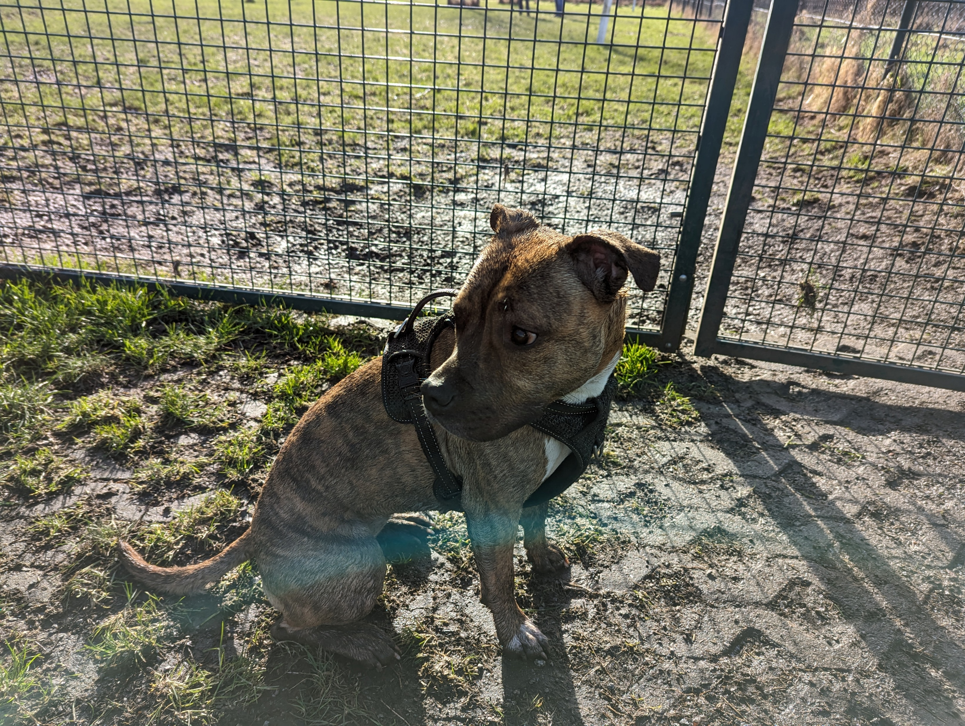
Dog person
Bad photographer

Slide 4
What am I talking about
The technology: F# and Wolverine
(Lambda) functions
Types
Piping data
Computational expressions
Discriminated unions
Pattern matching
Testing
Message handling

Slide 5
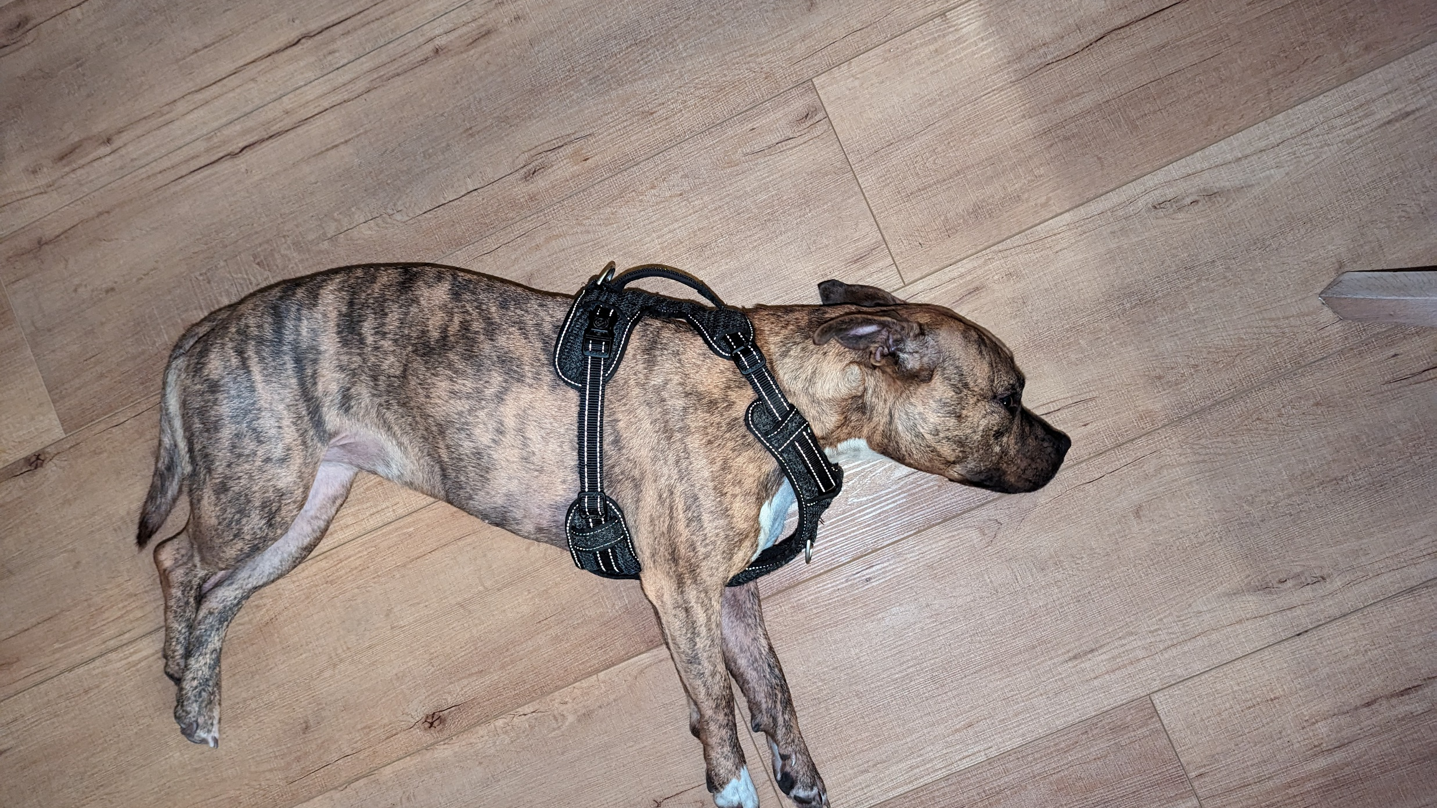
Notes:
Do not despair like my dog
Most of the terms I used sound scarier than they are
The most difficult one is computational expressions and that is only true when you want to create them
deprived of constant attention

Slide 6
Demo application
Drone flight tracking app
Overly simplistic, misses concepts
Nice showcase of what F# can do

Slide 7
The technology
F#
Functional first, OO second
Less boilerplate, concise
Dotnet ecosystem compatible
Scripting capabilities
Order is important!
Wolverine
Messaging first
Minimalistic, yet extendable
Reliable
Easy to understand

Slide 8
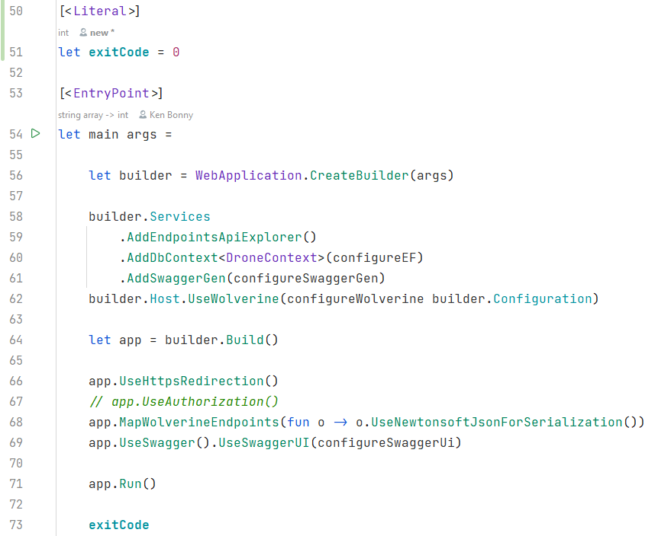
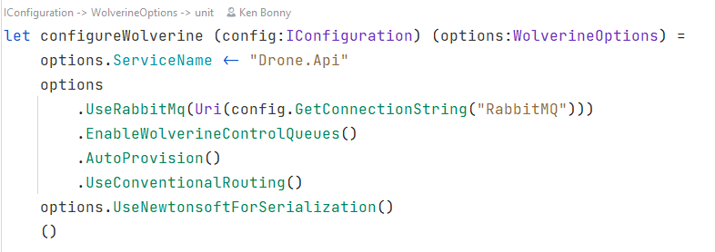
The API setup
Notes:
Order is important
Function and value creation with let
Partial application of a function
F# is full of nice little tricks like this

Slide 9
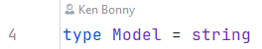
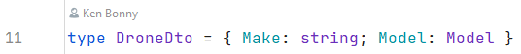
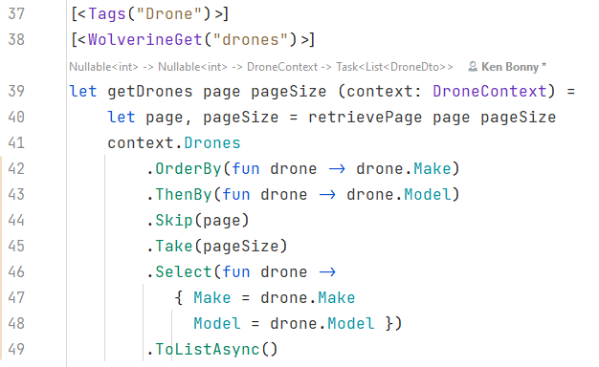
Retrieving a list of drones
Notes:
Model is a type alias, more descriptive than a regular string
Can be used in model binding and return values
Plays nice with entity framework
Wolverine specific attributes
- Tags for swagger grouping
- get for the path
Page + pageSize are query params
DroneContext is injected
Wolverine uses static functions and F# functions translate to those
Wolverine uses specific DI container called Lamar that allows this

Slide 10
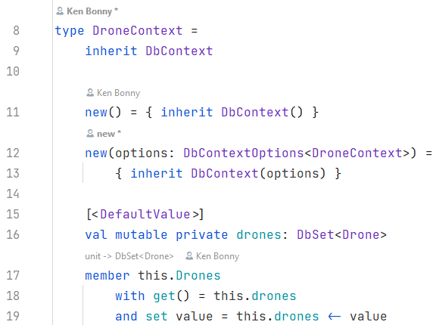
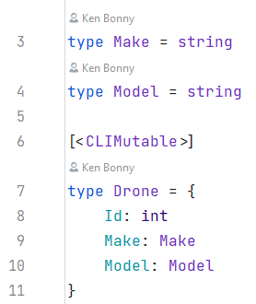
EF setup
Notes:
Pretty straightforward creation of a class
More code than auto properties from C#
Solved with a template
All table definitions need either mutable properties/fields
Or the entire type needs the [CLIMutable] attribute
This allows the runtime to modify the properties/fields, but in code the compiler will still treat it as immutable values

Slide 11
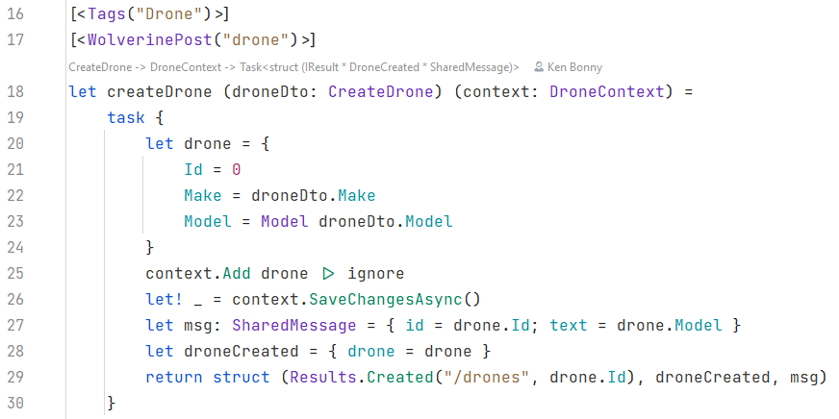
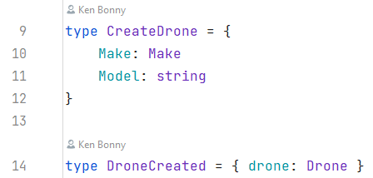
Creating a new drone
Notes:
Types and aliases, already familiar
The [CLIMutable] attribute is an EF necessity
CreateDrone is the DTO the endpoint will accept
DroneCreated is one of the messages we will send through Wolverine
The attribues will be familiar
The DTO will nicely be deserialised by the framework and the context injected
But now we get to something interesting: task {}
Called computational expression, used for all sorts of computations, this case: await
That is what the let! (pronounced let bang) does: in the context of the task, it acts as the await keyword in C#

Slide 12
Computational Expressions
Convenient syntax for writing computations that can be sequenced and combined using control flow constructs and bindings
In task context, let! is equivalent to await in C#
Return values are specified with the return keyword
There is a return! keyword in most cases too
Notes:
That is what the let! (pronounced let bang) does: in the context of the task, it acts as the await keyword in C#

Slide 13
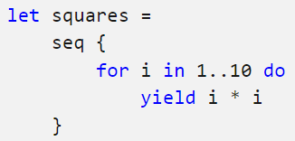
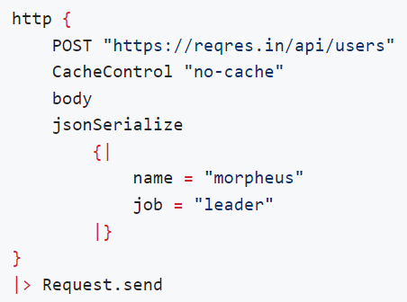
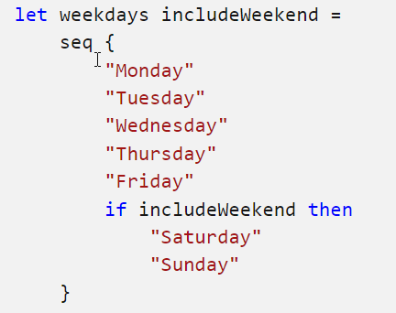
Examples
Seq
FsHttp
Notes:
Seq is the equivalent of Ienumerable
Can contain conditional logic
Can be used as a DSL (Domain Specific Language) such as for http requests

Slide 14
Creating a new drone
Notes:
Next to the computational expression, there is another interesting thing going on: the struct tuple

